Slide 1
Informational talk on Python and Python class
Empowering Middle School Education with Python
Presented by:
Dr. Sarah Hosni
Lecturer, Computer Science Department
Old Dominion University (ODU)
CS for Middle Schools (CS4MS) Workshop

Slide 2

Agenda
Why Learn Programming?
Introduction to Python
Why Learn Python?
Python in Education
Overview of the Python Class at ODU
Python in Action: Live Demo
Q&A

Slide 3
The Modern Necessity of Programming
Programming: A Universal Language in the Digital Age. It is becoming a necessity across all disciplines.
Enables you to "stick your nose into any field" – a tool for interdisciplinary exploration.
Regardless of your field, programming empowers you to push boundaries and innovate.
Essential for integrating specialized knowledge with cutting-edge tech.
Vital for navigating and commanding our digital assistants – from smartphones to AI.
A key driver for productivity, efficiency, and new interdisciplinary knowledge creation .

Slide 4
Beyond Computer Science: The Computational Revolution
Emergence of 'Computational' fields – blending traditional study with digital innovation.
Examples: Computational Neuroscience, Computational Biology,
Shift toward data-driven analysis and high-level problem-solving.
Data Science: Identifying and predicting complex data to extract actionable insights.
Involves statistics, data analysis, and machine learning.
Cybersecurity: Safeguarding information in an era of digital vulnerability.
Focuses on protecting systems, networks, and data from digital attacks.

Slide 5

Introduction to Python
What is Python?
Why learn Python?
*”Zen of Python”: image generated using ChatGPT

Slide 6
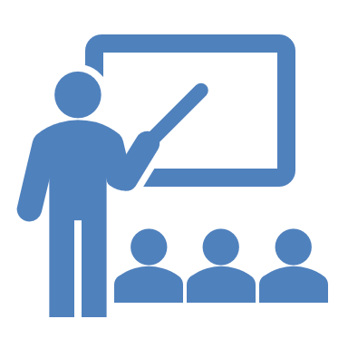
Why Learn Python?
Ease of Learning: Python’s simple and intuitive syntax makes it an excellent choice for beginners.
Versatility and Applications:
Web Development: Frameworks like Django and Flask.
Data Science: Libraries like Pandas, NumPy, and Matplotlib.
Machine Learning: Libraries like TensorFlow, Keras, and scikit-learn.
Automation: Scripts for automating tasks.
Job Market and Careers:
- High demand: Python is one of the most in-demand programming languages.
- Diverse career opportunities: Roles in web development, data science, machine learning, automation, and more.
Notes:
Perfect Balance: Beginner to Expert
Beginner-Friendly: Simple and intuitive syntax makes it ideal for beginners.
Accessible: Easy to learn, fostering widespread adoption.
Advanced Capabilities: Widely used by experts in cutting-edge fields.
Community & Support: Extensive resources and active community.
Versatility and Applications
Web Development: Frameworks like Django and Flask.
Data Science: Libraries like Pandas, NumPy, and Matplotlib.
Machine Learning & Deep Learning: TensorFlow (Google), Keras, and PyTorch (Facebook).
Automation: Scripts for automating tasks.
Industry Adoption
Major Tech Companies:
Google: Uses Python for web search systems, data analysis, and AI projects.
Facebook: Developed PyTorch, extensively used in machine learning.
Netflix: Utilizes Python for data analysis and backend services.
NASA: Employs Python for scientific computing and workflow automation.
Instagram: Relies on Python (Django) for handling large-scale user data.
Spotify: Uses Python for backend services and data analysis.
Dropbox: Implements Python for various backend processes and services.
Community and Open Source
Open-Source Nature: Python is free and open-source, with a rich ecosystem of libraries and tools.
Community Contributions: Major companies and independent developers contribute to Python’s growth.
Extensive Resources: Tutorials, forums, and documentation available for learners at all levels.
Job Market and Careers
High Demand: Python is one of the most in-demand programming languages.
Diverse Career Opportunities: Roles in web development, data science, machine learning, automation, and more.
Industry-Relevant Skills: Knowledge of Python opens doors to cutting-edge technology sectors.

Slide 7
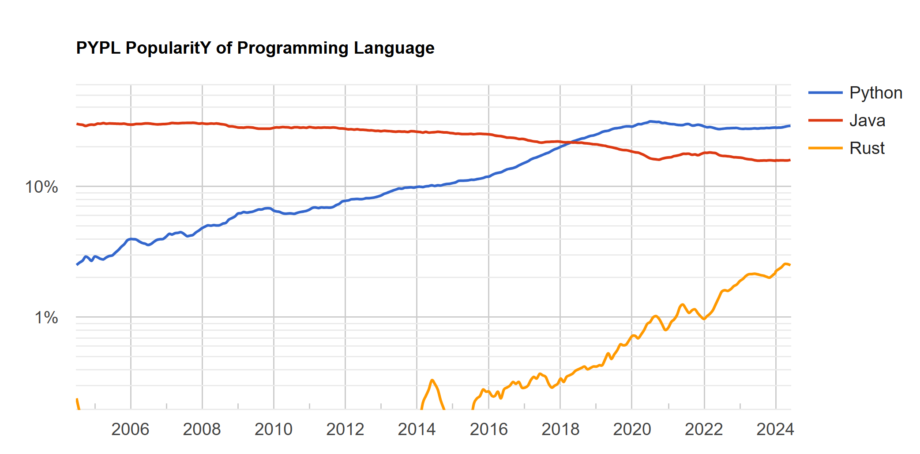

Slide 8


Python at ODU: CS153
CS 153 Introduction to Programming with Python (4 Credit Hours)
Introduction to computer-based problem solving and programming in Python.
Problem solving methodologies, program design, algorithm development, and testing.
Python language concepts: variables, data types and expressions, assignment, control-flow statements, functions, data collections, classes, and files
Class Structure:
- Lectures: Covering fundamental concepts and syntax.
- Hands-on coding : challenging activities and labs
- Assessments: Quizzes and coding exams to test understanding.
Learning Outcomes:
- Basic Python programming skills.
- Data manipulation and visualization.
- Understanding of simple algorithms.
- Ability to develop and debug Python projects.

Slide 9
Python at ODU: CS153
Multidisciplinary Approach
Designed to provide a solid foundation in programming for computer science majors while offering a straightforward entry point for students from other disciplines.
Career and Academic Advancement
Equips students with the skills to explore data-driven fields like data science and demonstrate how coding skills can enhance studies and professional work across various domains.
Empowering Students:
Encourages students to "dip their toes" into any field by leveraging Python as a powerful tool to enhance their studies and professional opportunities.
CS153 aims to set students on a learning journey where they can:
Understand Code Independently: Develop the ability to comprehend and write code without constant guidance.
Explore Multiple Paths: Open doors to web development, game development, and adding a computational dimension to their field of expertise.

Slide 10

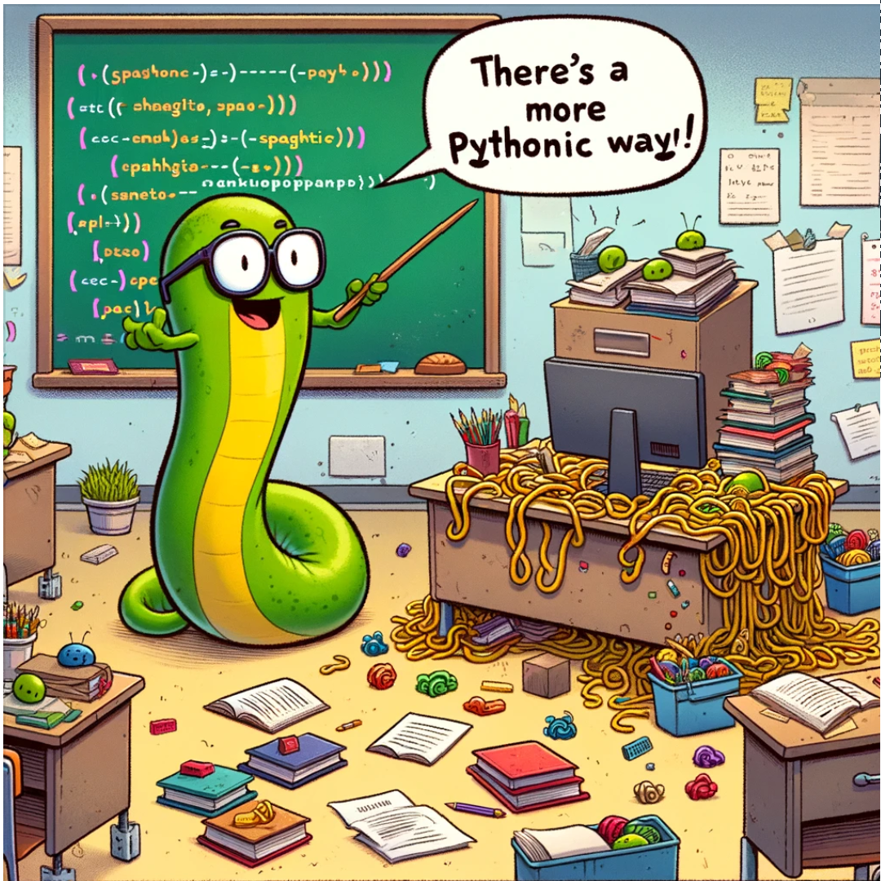
Python for MS Education
Benefits for Students
Skill Enhancement: Improves problem-solving skills, logical thinking, and creativity.
Engagement: Engages students with interactive and practical projects.
Integrating Python with Core Subjects
Math: Step-by-step problem-solving and visualization.
Science: Simulating experiments, data analysis.

Slide 11
Python for MS Education
Empowering Teachers:
Lesson Planning: Use Python to create dynamic lesson plans and educational tools.
Interactive Teaching: Using Python interactive Notebooks to develop engaging and interactive content for students.

Slide 12
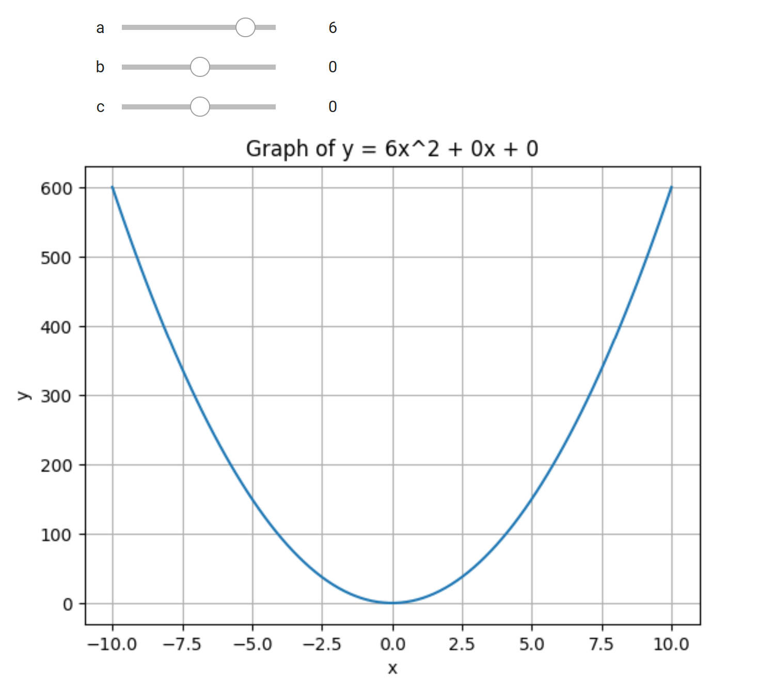
Python in Action: Live Demo
Exploring Polynomial Functions(CS4M).ipynb - Colab (google.com)

Slide 13
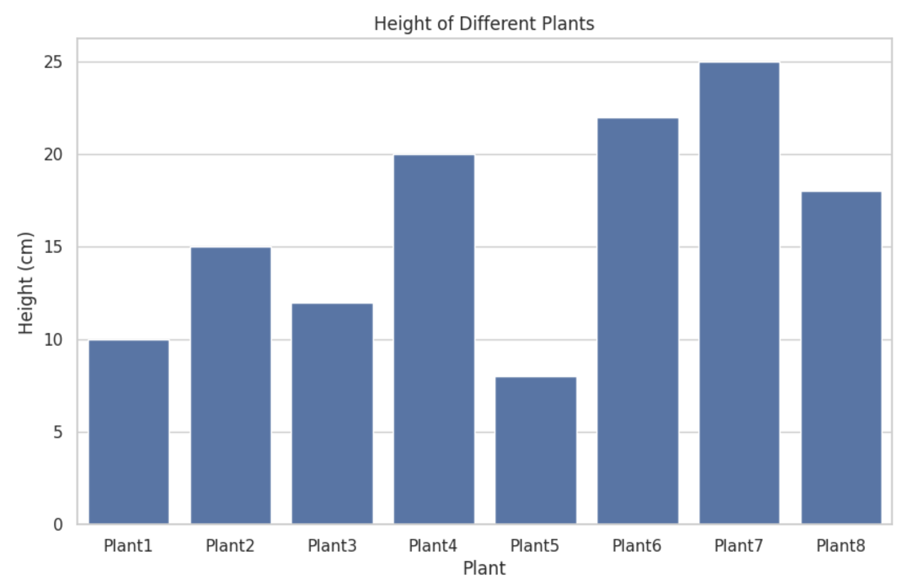
Python in Action: Live Demo
Analyzing Plant Growth (CS4M).ipynb - Colab (google.com)

Slide 14
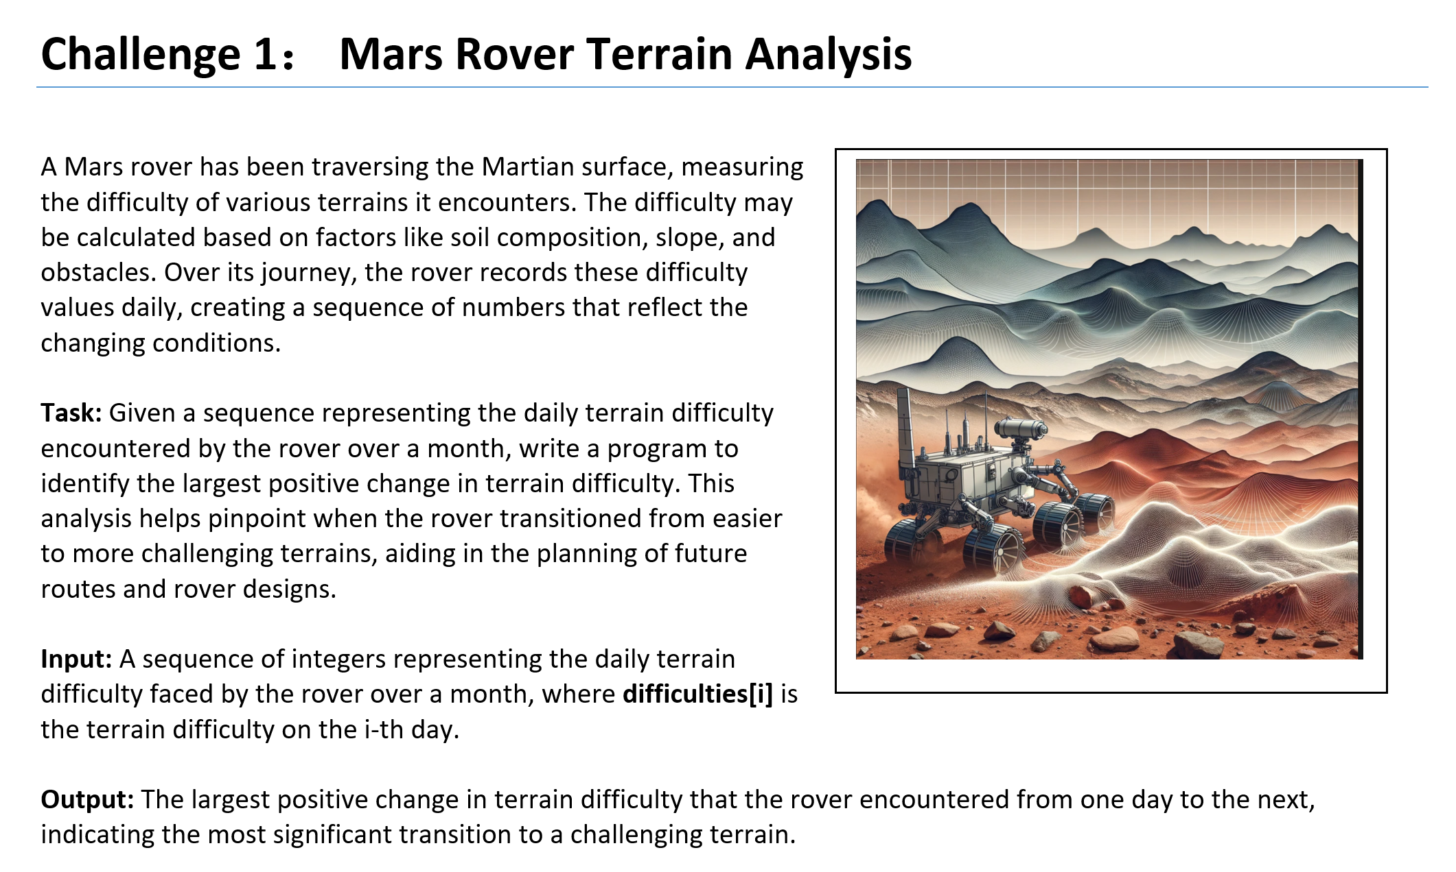
The Great Computer Challenge, 2024

Slide 15
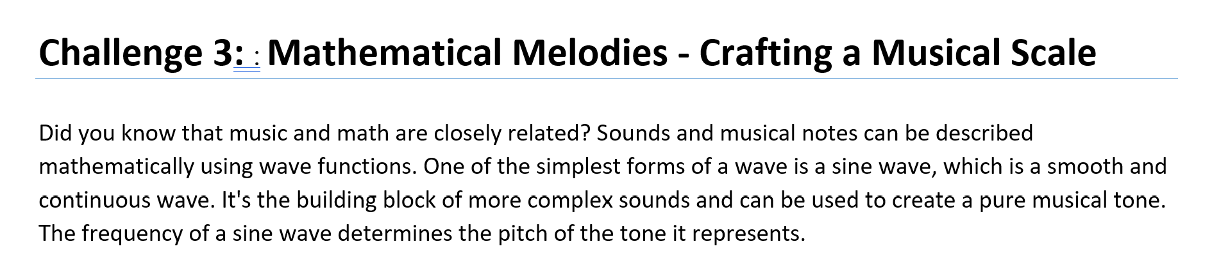
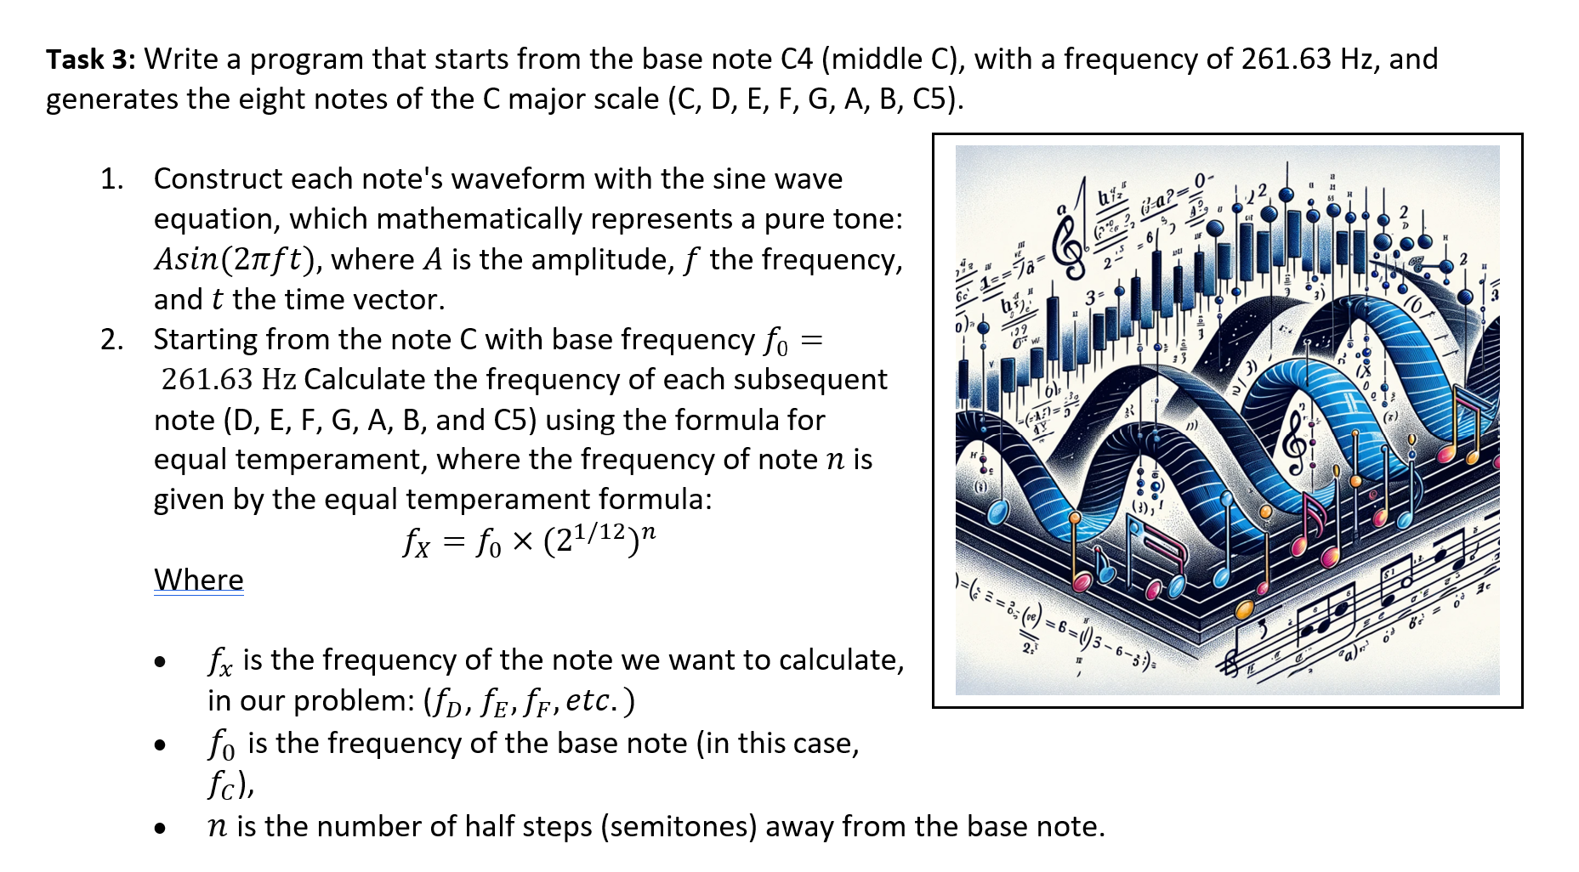
GCC_Audio.ipynb - Colab (google.com)

Slide 16
Q&A and References
Teaching and Learning with Jupyter (jupyter4edu.github.io)
Hacking math education with Python | Opensource.com

